Slide 1

INF3011F Final Presentation
Done by: Sibusiso Mayalo, Joshua Benjamin, Luvo Fokazi, Michael Scott

Slide 2
Introduction - Topic
The topic we were assigned was: the indexing of research publications by the IS department.
The output for this topic was: a catalogue.
This catalogue would enable lecturers to search by different categories:
Authors
Research areas
Research methods
Frameworks

Slide 3
Background
The Department of Information System is embarking on an initiative to review and streamline some its administrative operations as well as come up with new and innovative ways of doing things. The initiative is in line with the department’s mission of being the leading African centre for Information Systems research and education.

Slide 4
Situation of Concern:
There are multiple facets of tracking the research output throughout the university.
However, the IS department lacks a ‘robust’ internal system to keep track of its individual research output.
Our team’s job was to rectify this issue

Slide 5
Approach
The breakdown of the approach we took with this project:
Outlining the problem– meeting stakeholders
Defining the problem – internal meeting
Brainstorming the solution
Building the solution – prototype
Testing the solution – prototype run-through with stakeholders
Improving the solution – prototype feedback

Slide 6
Problem Outline
This is the first step in the process.
This phase was executed by meeting with our stakeholders:
Lecturers/Researchers
Postgraduates
Director of the research unit in the IS department (AKA CITANDA)
And guided by meeting with our mentor & course convenor respectably:
Mbongeni Ncube
Gwamaka Mwalemba

Slide 7
Defining Problem & Solution Development
This phase was done internally by meeting amongst group members
The problem was clearly defined
Then solutions were brainstormed and a final solution was decided on

Slide 8
Prototyping & Testing Solution
A prototype was developed for the final solution
We met previous as well as new stakeholders to do a prototype walkthrough
Feedback was taken into account & the prototype was iterated upon.

Slide 9
The Solution:
Microsoft Access Database
Forms for the User Interface
Queries and Macro Events to drive most of the database functionality
Visual Basic to drive the more intricate functionality

Slide 10
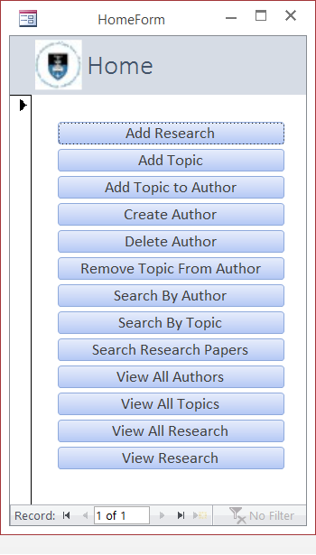
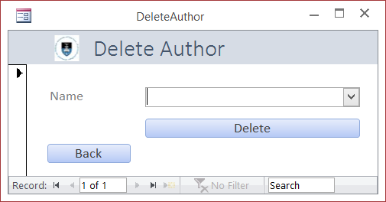
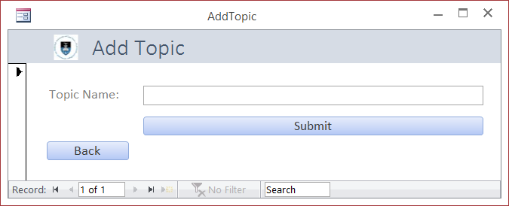
The Solution – Forms:

Slide 11
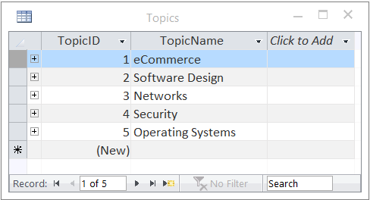
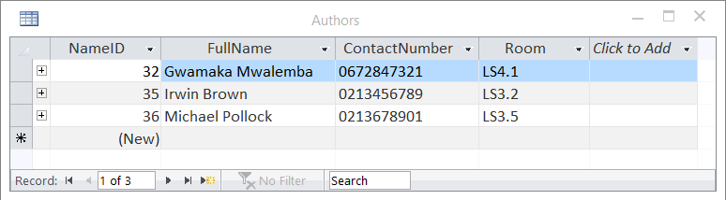
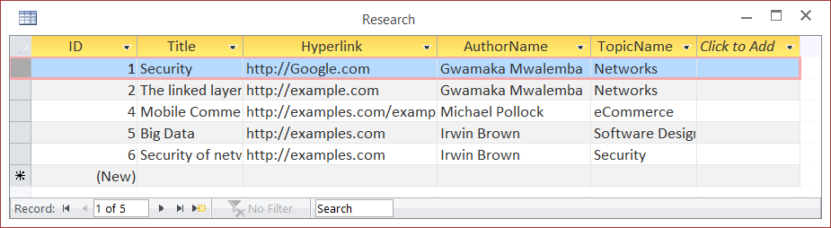
The Solution – Database Tables

Slide 12
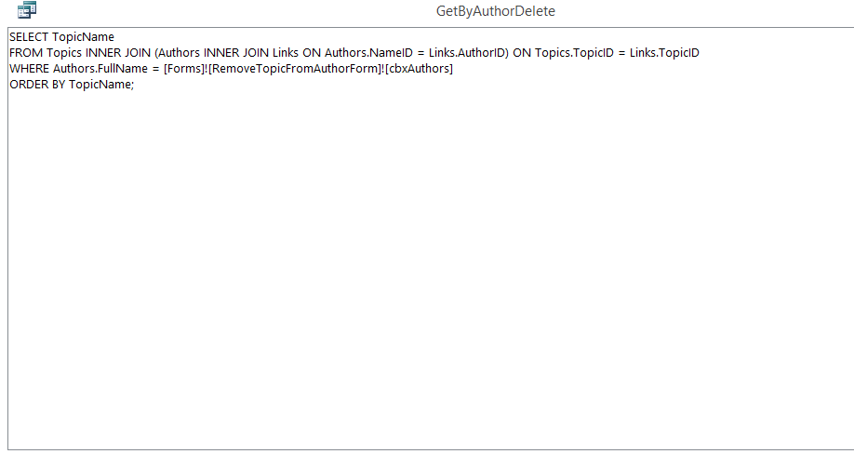
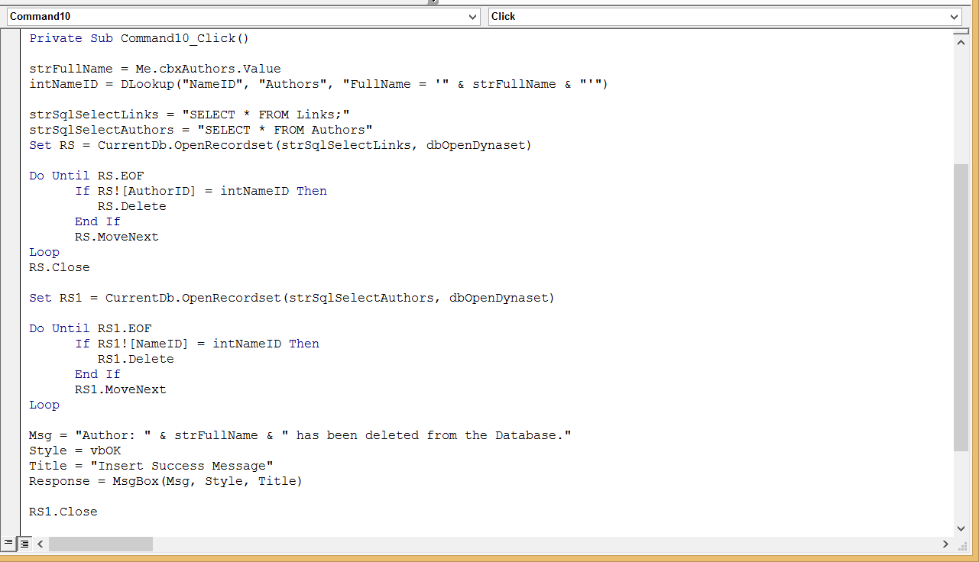
The Solution – Miscellaneous

Slide 13
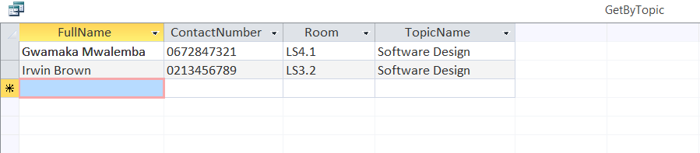
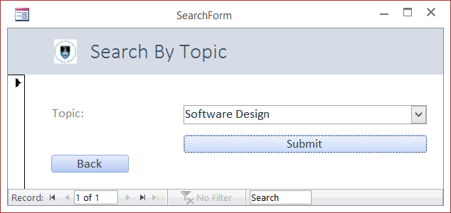
Solution Run-through Example

Slide 14
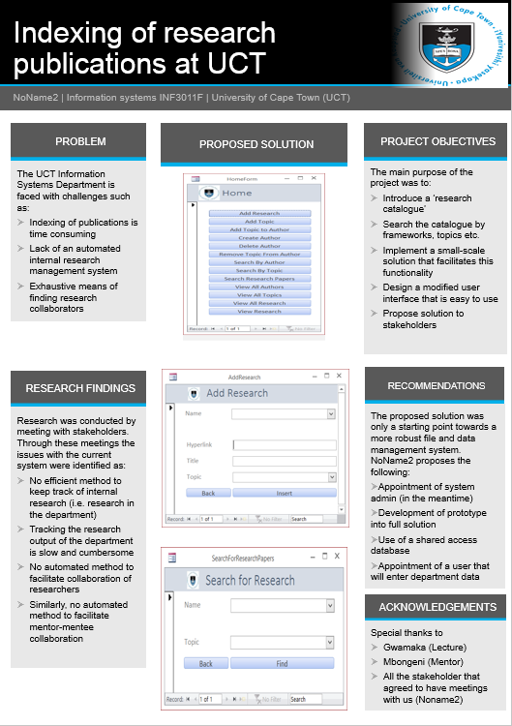
Poster Presentation
Snapshots
of our
Solution
Our objectives
Problem
Definition
Our
Findings
Recommendations
Acknowledgements

Slide 15
Team Reflection – Project Management
Lessons we have learned:
There’s no substitute to being prepared
It is always important to keep the initial project goals and scope in mind
Everything that gets done on a project will have an associated risk, preparing and managing risks saves a substantial amount of time and stress
Breaking down the workflow allows many people to work concurrently on different things

Slide 16
Team Reflection – People Management
Lessons we have learnt:
Early communication is often the best type of communication
Communication is not an event, it is an ongoing process and should happen as often as possible
Be upfront with your issues, issues that go unresolved become more complicated as the project goes on.
Techniques to apply to real world project work:
Conflict resolution
Leaderful practice
Dynamic Management

Slide 17

Questions:

